Slide 1


 | Nitte Meenakshi Institute of Technology (AN AUTONOMOUS INSTITUTION AFFILIATED TO VISVESVARAYA TECHNOLOGICAL UNIVERSITY, BELGAUM) PB No. 6429, Yelahanka, Bangalore 560-064, Karnataka Telephone: 080- 22167800, 22167860, Fax: 080 - 22167805
Department of Computer Science and Engineering
AR Application for Architects and Interior Designers
Group No. 017
Presentation By:
Ritehsh Shanmughan (1NT17CS151)
Rahul Khatri (1NT17CS142)
Sai Siddhanth A (1NT17CS158)
Utsav Mondal (1NT17CS217)
Guided By:
Name of the Guide: Mrs. Nirmala J S
Designation: Assistant Professor

Slide 2
TABLE OF CONTENTS
 | Nitte Meenakshi Institute of Technology (AN AUTONOMOUS INSTITUTION AFFILIATED TO VISVESVARAYA TECHNOLOGICAL UNIVERSITY, BELGAUM) PB No. 6429, Yelahanka, Bangalore 560-064, Karnataka Telephone: 080- 22167800, 22167860, Fax: 080 - 22167805
Department of Computer Science and Engineering
Background
Research motivation and Problem statement
Research objectives
Literature Survey
System Requirements
Incorporation of changes mentioned in Phase 1
Design
Implementation
Conclusions
References

Slide 3
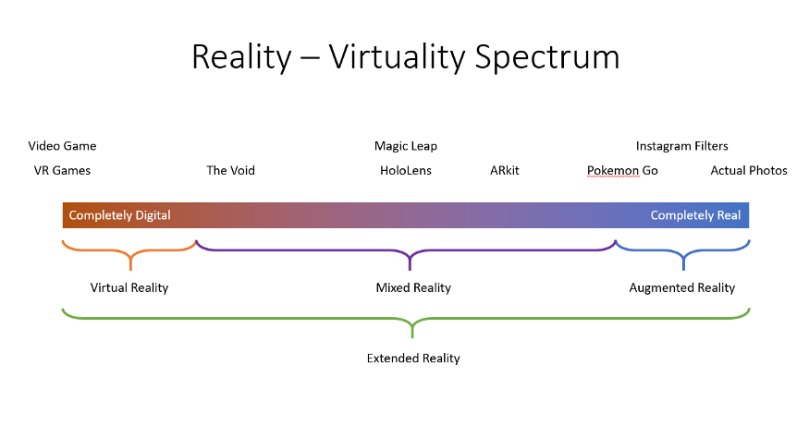
Background Reality spectrum

Slide 4

Virtual Reality (VR) is the use of computer technology to create a simulated environment. Unlike traditional user interfaces, VR places the user inside an experience. Instead of viewing a screen in front of them, users are immersed and able to interact with 3D worlds

Slide 5
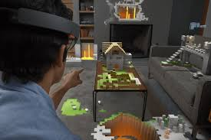
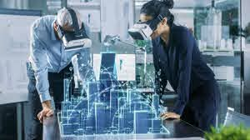
Augmented reality (AR) is an interactive experience of a real-world environment where the objects that reside in the real world are enhanced by computer-generated perceptual information
Mixed reality (MR) is the merging of real and virtual worlds to produce new environments and visualizations, where physical and digital objects co-exist and interact in real time. Mixed reality does not exclusively take place in either the physical or virtual world, but is a hybrid of reality and virtual reality

Slide 6
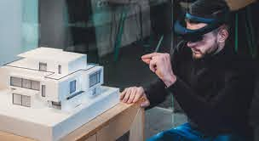
Use of AR in the field for Architects and Interior designers
Although the idea to use AR for architecture, engineering and construction dates back to the early 1996’s and AR has actually matured from a pure research field into certain practical industrial applications, until now it has not been implemented as a real product in architecture and design. In contrast, architecture and design communities apparently have the knowledge of the operations/tasks that AR could potentially enhance as well as the motivation to bring in this new technology for improving the current practices

Slide 7
Research Motivation And Problem statement
Nowadays with excessive workload and busy life, many professionals face problems that result in the loss of their clients or the certain overheads that spoil the process of satisfying the client.
AR/VR helps to remove some of the fear and anxiety that a client might have about committing to a design plan that they are unsure of and achieve 98% closure rate. The proposed software will be used by interior designers or architects.
This proposed research most likely acts as an effective tool which can decrease the gap between industrial company and customer in addition to other applicable business communities.
The print media (images, panaflex, print outs) influence is not capable and sufficient to satisfy designers and architects to visualize their ideas and complicated stuff in their desired way in the real-world environment.

Slide 8



Research Objective
Use of AR camera for the detection of ground plane.
Rendering of room(architectural structure)and the interiors.
Integration with android device.
Screen control.
Gesture Recognition.

Slide 9
Literature Review
Year | Title | Author Name | Inference
2012 | Virtual Reality Practice in Architecture Design | Ping Su, Shuo Wang | Virtual reality simulated environment Lack of Interface with Architecture Design Software Lack of Convenient and Efficiency in Design Lack of Interactive Performance in Architecture Behaviour Integration with VR Platform and Architecture Design Technolog Enhance the VR Interactive Performance in Architecture Simulation

Slide 10
Literature Review
Year | Title | Author Name | Inference
2014 | AR Interior Designer: Automatic Furniture Arrangement using Spatial and Functional Relationships | Jeff K.T. Tang Wan-Man Lau -Kit Chan Kwok-Ho | Use of Virtual 3D furniture Using the in-depth camera in real time as an input Estimation and optimisation of the available space in a room The friendly User Interface

Slide 11
Literature Review
Year | Title | Author Name | Inference
2015 | Approach to The Interior Design using Augmented Reality Technology | Jiang Hui | Uses marker based AR Uses Hard-Soft decorative in-built models to design a room Use of ARID system in the conceptual development design stage and AR3D for custom model
2016 | Interior Design using Augmented Reality Environment | Kalyani Pampattiwar, Akshay Adiyodi , Manasvini Agrahara , Pankaj Gamnani1 | Enhanced Marker Based AR Easy user interactivity Rendering real world objects in AR

Slide 12
Literature Review
Year | Title | Author Name | Inference
2018 | Augmented Reality Application for Architects and interior designers: Interno A cost effective solution | Augmented Reality Application for Architects and interior designers: Interno A cost effective solutionSidraNasir , Mohammad Noman Zahid, Talha Ahmed Khan , Kushsairy Kadir, Sheroz Khan | Uses AR for previewing User interactivity Uses AR trackers Virtualising the real world in 2D

Slide 13
System Requirements
Hardware: PC capable of supporting high level graphic,Mobile device supports Vuforia and ArCore.
Software: Unity 3D, Vuforia, ArCore, Android Studio

Slide 14
Incorporation of changes in phase 2
Change in Methodology
rather than implementing the functionalities sequentially we decided to identify the basic modules and implementation
Vuforia was replaced by AR foundation, ARCore & ArKit
Gesture Recognition was replaced by Voice command .

Slide 15
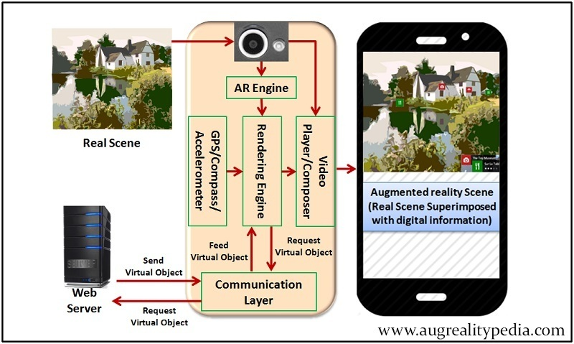
Design

Slide 16



Implementation
Game Engine : Unity 3D
API/Plugin:

Slide 17
Modules
Room Rendering
Ground Plan Detection
Object positioning
Translations
Integration

Slide 18
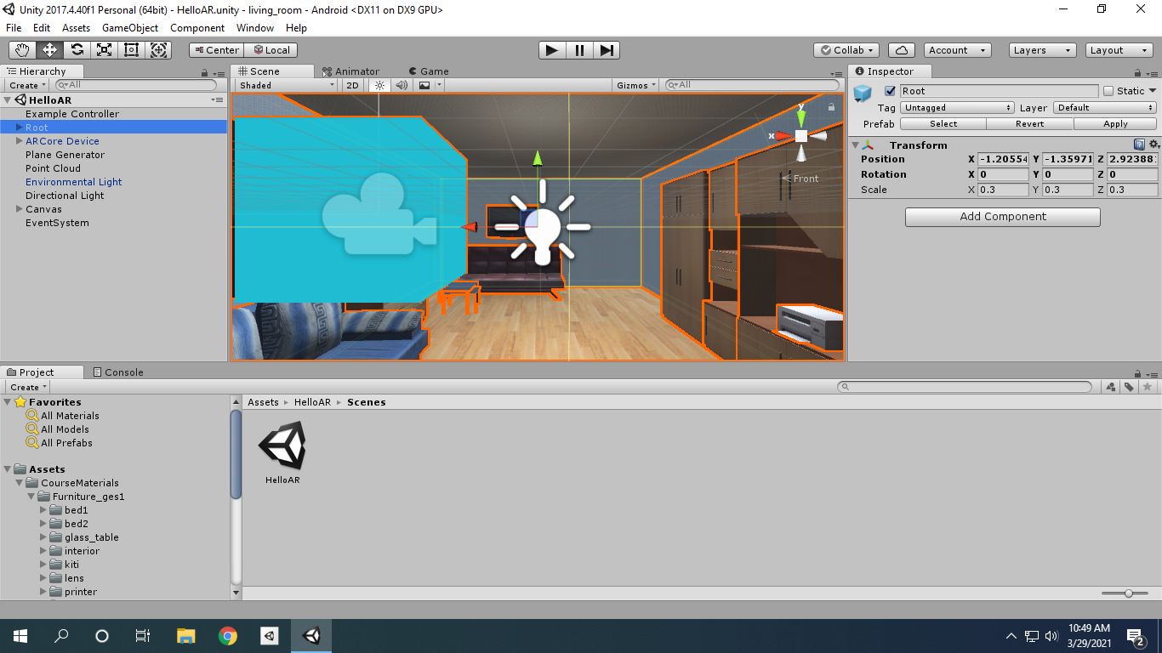
Implementation

Slide 19
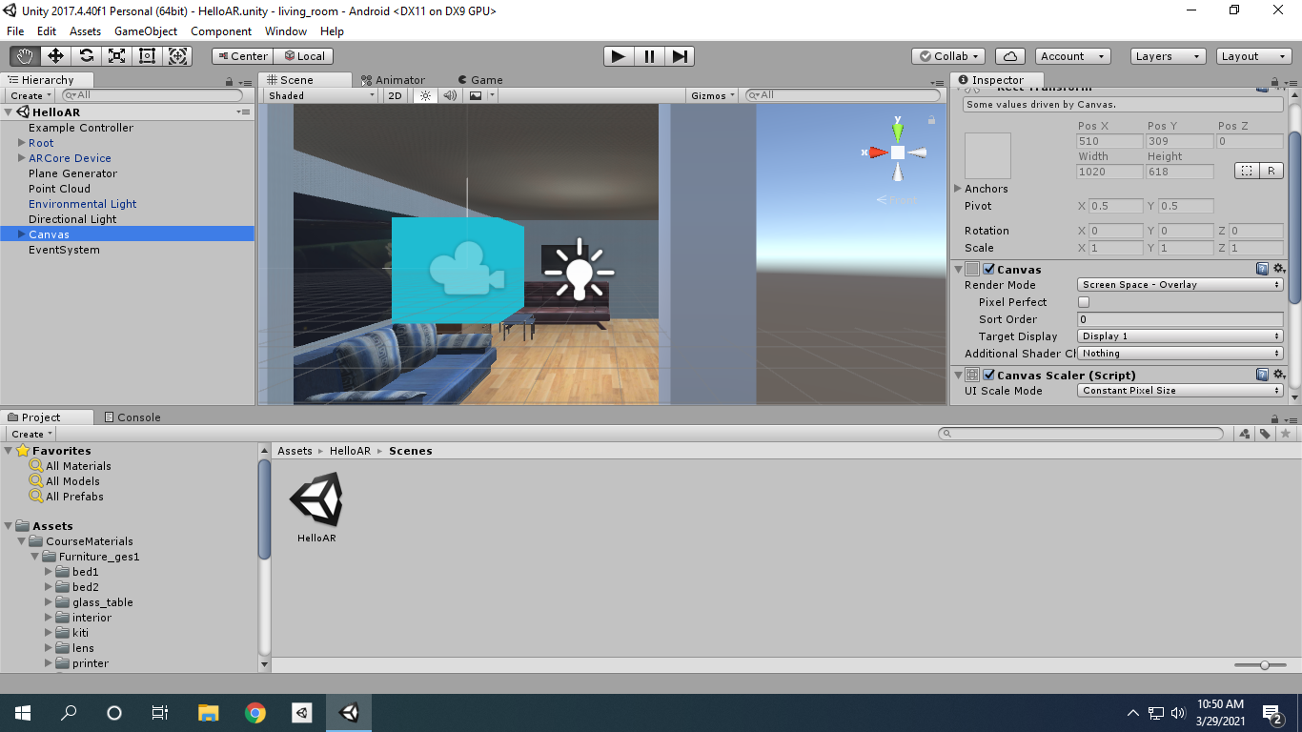
Implementation

Slide 20
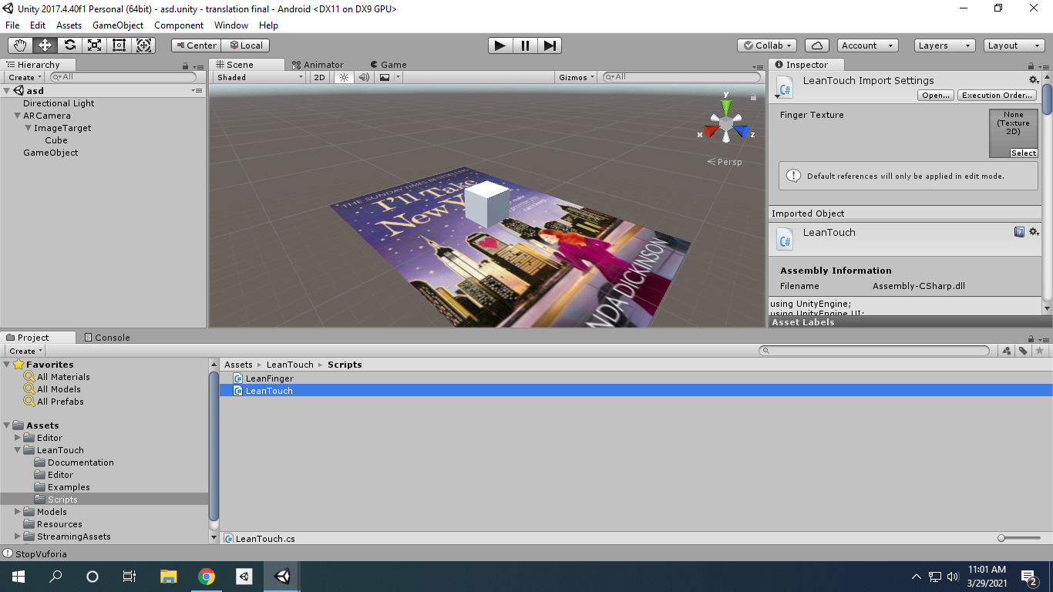
Implementation

Slide 21
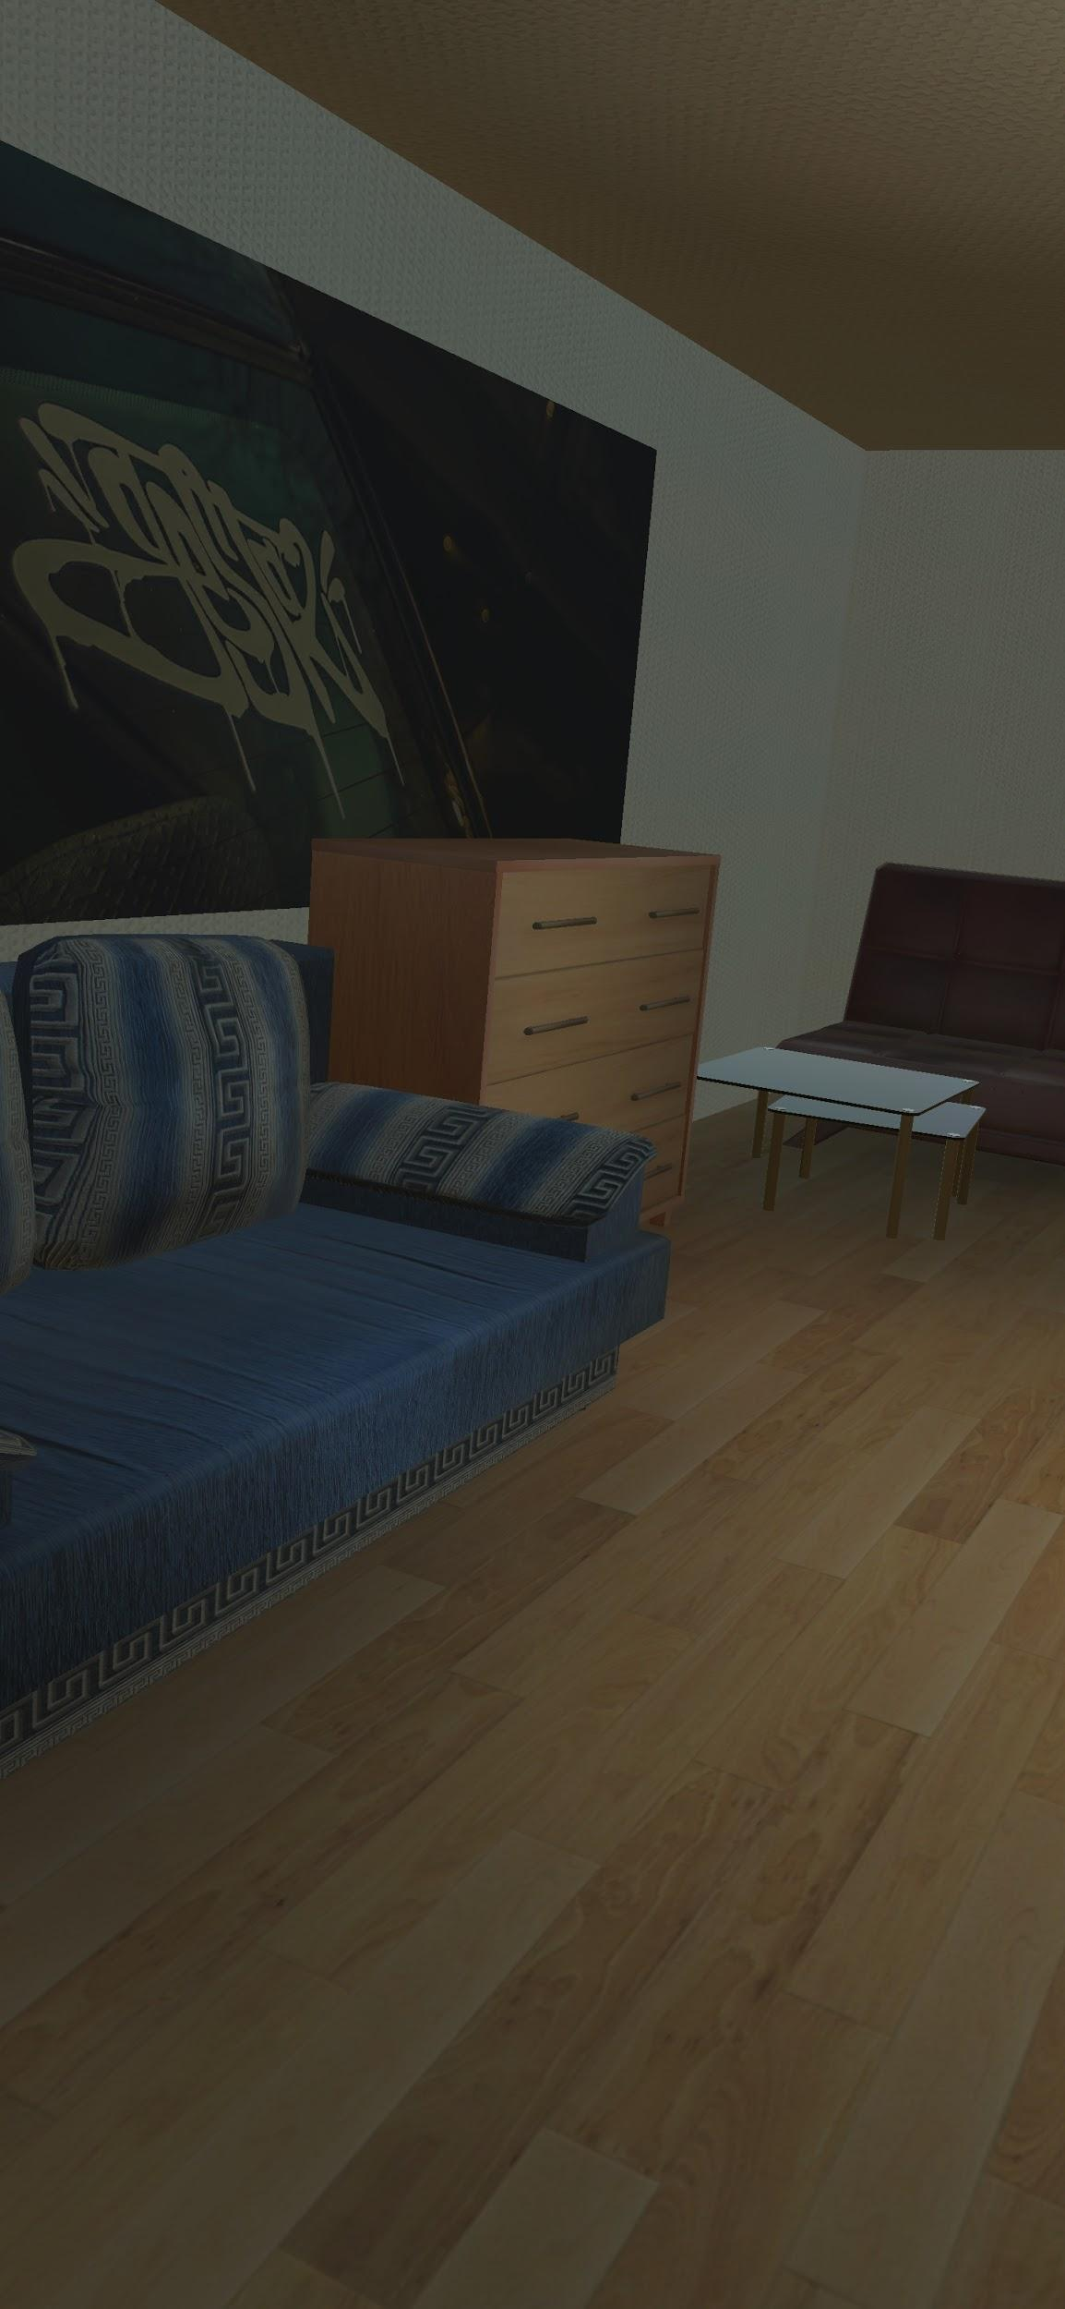
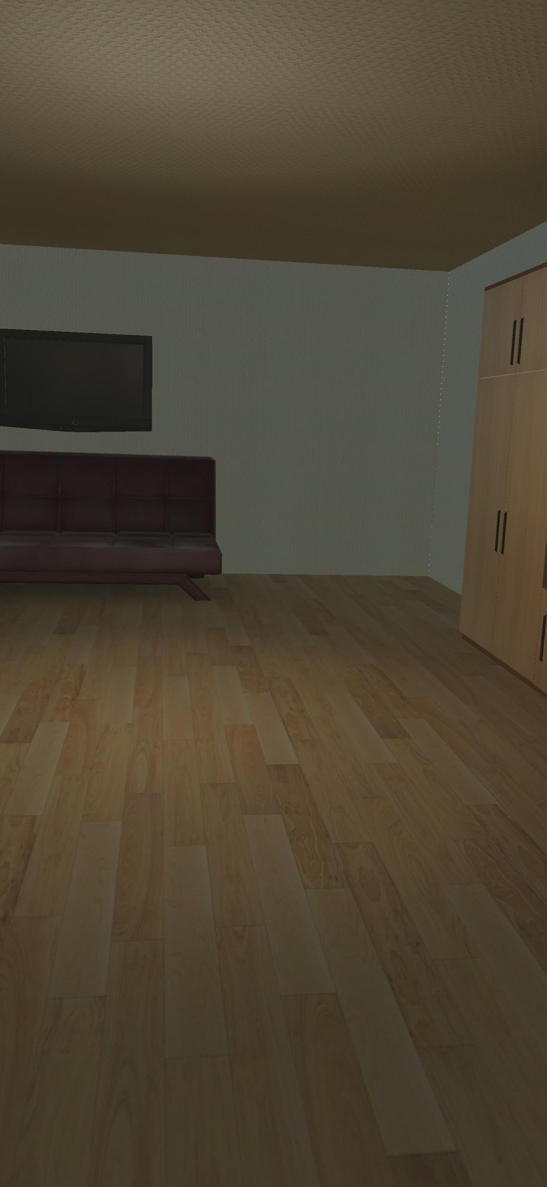
Results

Slide 22


Results

Slide 23

Results(Demonstration)

Slide 24
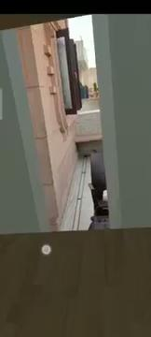
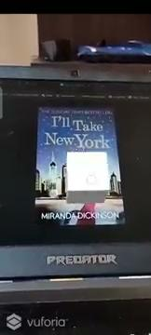
Results(Demonstration)

Slide 25
Results(Demonstration)

Slide 26
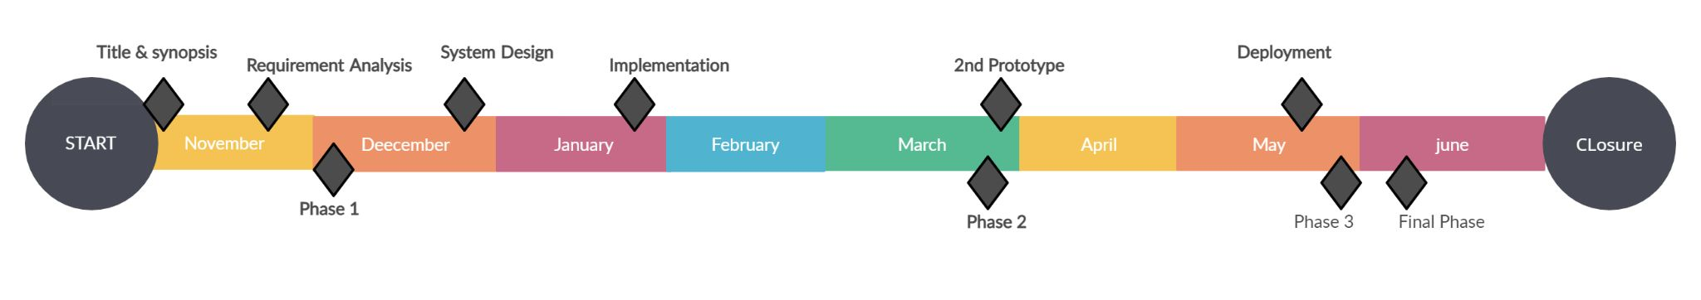
Timeline

Slide 27
CONCLUSION
We conclude that our project will be an enhancement all the other products in the field of AR for architects and interior designers with ease to use features by utilizing the current technology with cost efficiency.

Slide 28
Survey Paper Title
“Use of AR in Construction“

Slide 29
References
Virtual Reality Practice in Architecture Design; Ping Su, Shuo Wang
AR Interior Designer: Automatic Furniture Arrangement using Spatial and Functional Relationships; Jeff K.T. Tang , Wan-Man, Lau -Kit Chan, Kwok-Ho
Approach to The Interior Design using Augmented Reality Technology ;Jiang Hui
Interior Design using Augmented Reality Environment; Kalyani Pampattiwar, Akshay Adiyodi , Manasvini Agrahara , Pankaj Gamnani1
Augmented Reality Application for Architects and interior designers: Interno A cost effective solution; SidraNasir , Mohammad Noman Zahid,Talha Ahmed Khan , Kushsairy Kadir, Sheroz Khan

Slide 30
References
B. Cvetkoska, N. Marina, D. C. Bogatinoska, and Z. Mitreski, "Smart mirror E-health assistant — Posture analyze algorithm proposed model for upright posture," IEEE EUROCON 2017 -17th International Conference on Smart Technologies, Ohrid, 2017, pp. 507-512. 2.
D. Gold, D. Sollinger and Indratmo, "SmartReflect: A modular smart mirror application platform," 2016 IEEE 7th Annual Information Technology, Electronics and Mobile Communication Conference (IEMCON), Vancouver, BC, 2016, pp. 1-7. 3.
M. Rodriguez-Martinez et al., "Smart Mirrors: peer-to-peer Web services for publishing electronic documents," 14th International Workshop Research Issues on Data Engineering: Web Services for eCommerce and e-Government Applications, 2004. Proceedings., 2004, pp. 121-128.

Slide 31
THANK YOU

